Slide 1
Principal Component Analysis

Slide 2
Outline
What is Principal Component Analysis?
b
c
d
e

Slide 3
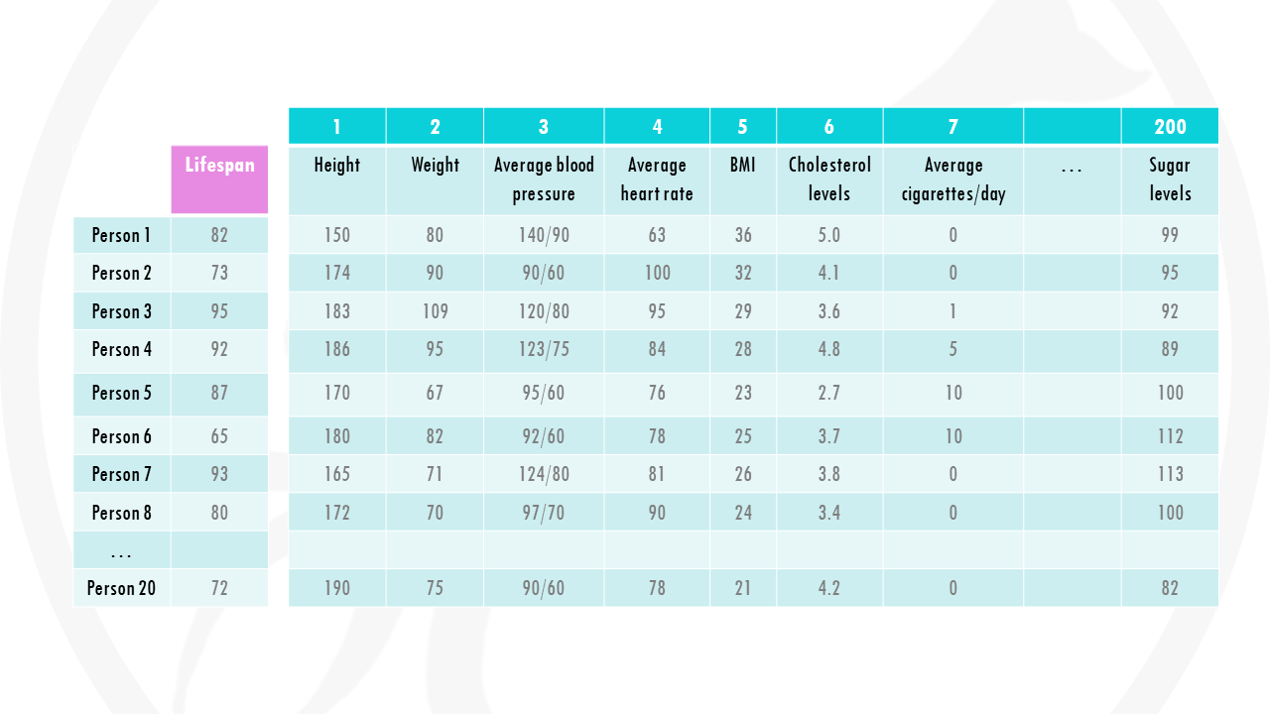

Slide 4
 | Lifespan | Height | Weight | Average Blood Pressure | Average Heart Rate | BMI | Cholesterol Levels | Average Cigarettes per day | Sugar Level
Person 1 | 82 | 150 | 80 | 140/90 | 63 | 36 | 5.0 | 0 | 99
Person 2 | 73 | 174 | 90 | 90/60 | 100 | 32 | 4.1 | 0 | 95
Person 3 | 95 | 183 | 109 | 120/80 | 95 | 29 | 3.6 | 1 | 92
Person 4 | 92 | 186 | 95 | 12/75 | 84 | 28 | 4.8 | 5 | 89
Person 5 | 92 | 170 | 67 | 95/60 | 76 | 23 | 2.7 | 10 | 100
Person 6 | 65 | 180 | 82 | 92/60 | 78 | 25 | 3.7 | 10 | 112
Person 7 | 93 | 165 | 71 | 124/80 | 81 | 26 | 3.8 | 0 | 113
Person 8 | 80 | 172 | 70 | 97/70 | 90 | 24 | 3.4 | 0 | 100

Slide 5
 | Lifespan | Height | Weight | Average Blood Pressure | Average Heart Rate | BMI | Cholesterol Levels | Average Cigarettes per day | Sugar Level
Person 1 | 82 | 150 | 80 | 140/90 | 63 | 36 | 5.0 | 0 | 99
Person 2 | 73 | 174 | 90 | 90/60 | 100 | 32 | 4.1 | 0 | 95
Person 3 | 95 | 183 | 109 | 120/80 | 95 | 29 | 3.6 | 1 | 92
Person 4 | 92 | 186 | 95 | 12/75 | 84 | 28 | 4.8 | 5 | 89
Person 5 | 92 | 170 | 67 | 95/60 | 76 | 23 | 2.7 | 10 | 100
Person 6 | 65 | 180 | 82 | 92/60 | 78 | 25 | 3.7 | 10 | 112
Person 7 | 93 | 165 | 71 | 124/80 | 81 | 26 | 3.8 | 0 | 113
Person 8 | 80 | 172 | 70 | 97/70 | 90 | 24 | 3.4 | 0 | 100

Slide 6

We cannot visualize so many dimensions all at once

Slide 7
 | Lifespan | Height | Weight | Average Blood Pressure | Average Heart Rate | BMI | Cholesterol Levels | Average Cigarettes per day | Sugar Level
Person 1 | 82 | 150 | 80 | 140/90 | 63 | 36 | 5.0 | 0 | 99
Person 2 | 73 | 174 | 90 | 90/60 | 100 | 32 | 4.1 | 0 | 95
Person 3 | 95 | 183 | 109 | 120/80 | 95 | 29 | 3.6 | 1 | 92
Person 4 | 92 | 186 | 95 | 12/75 | 84 | 28 | 4.8 | 5 | 89
Person 5 | 92 | 170 | 67 | 95/60 | 76 | 23 | 2.7 | 10 | 100
Person 6 | 65 | 180 | 82 | 92/60 | 78 | 25 | 3.7 | 10 | 112
Person 7 | 93 | 165 | 71 | 124/80 | 81 | 26 | 3.8 | 0 | 113
Person 8 | 80 | 172 | 70 | 97/70 | 90 | 24 | 3.4 | 0 | 100

Slide 10
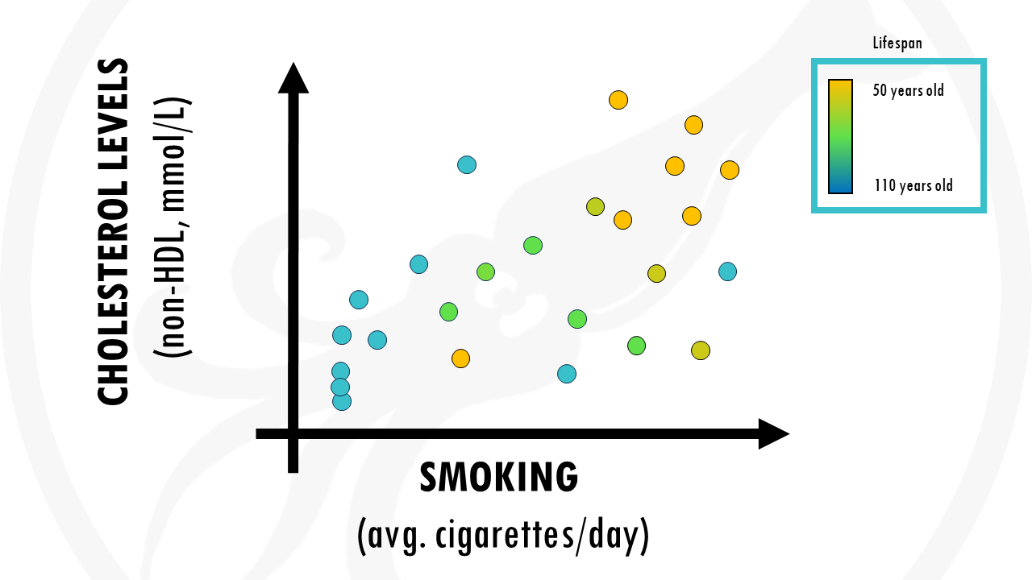

Slide 11

Is there a way of taking into account all factors?

Slide 12
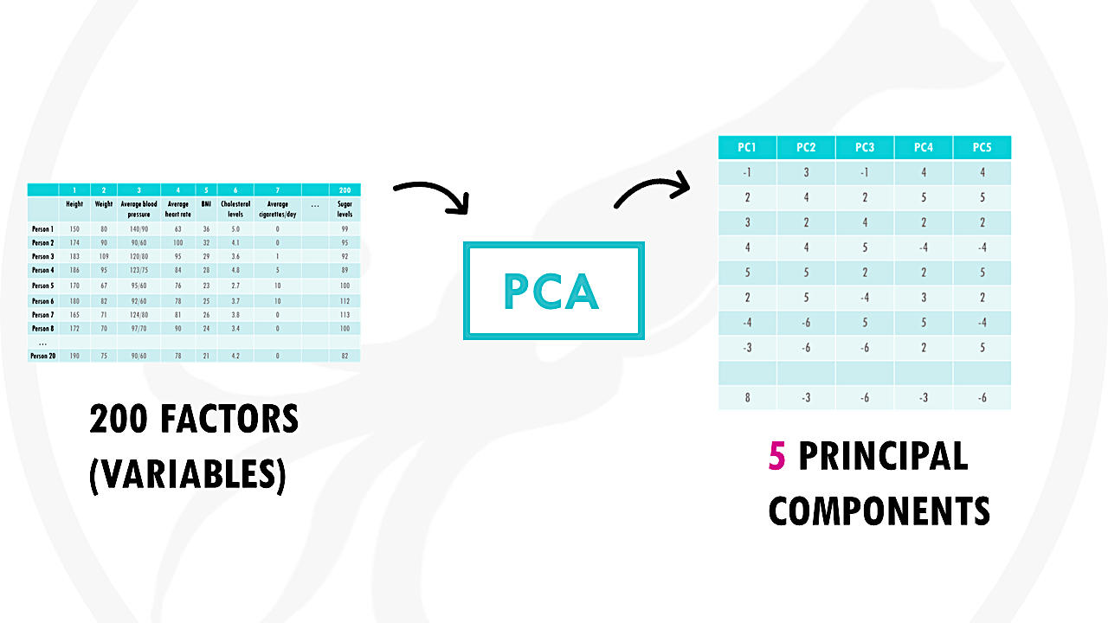
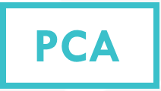

Slide 13
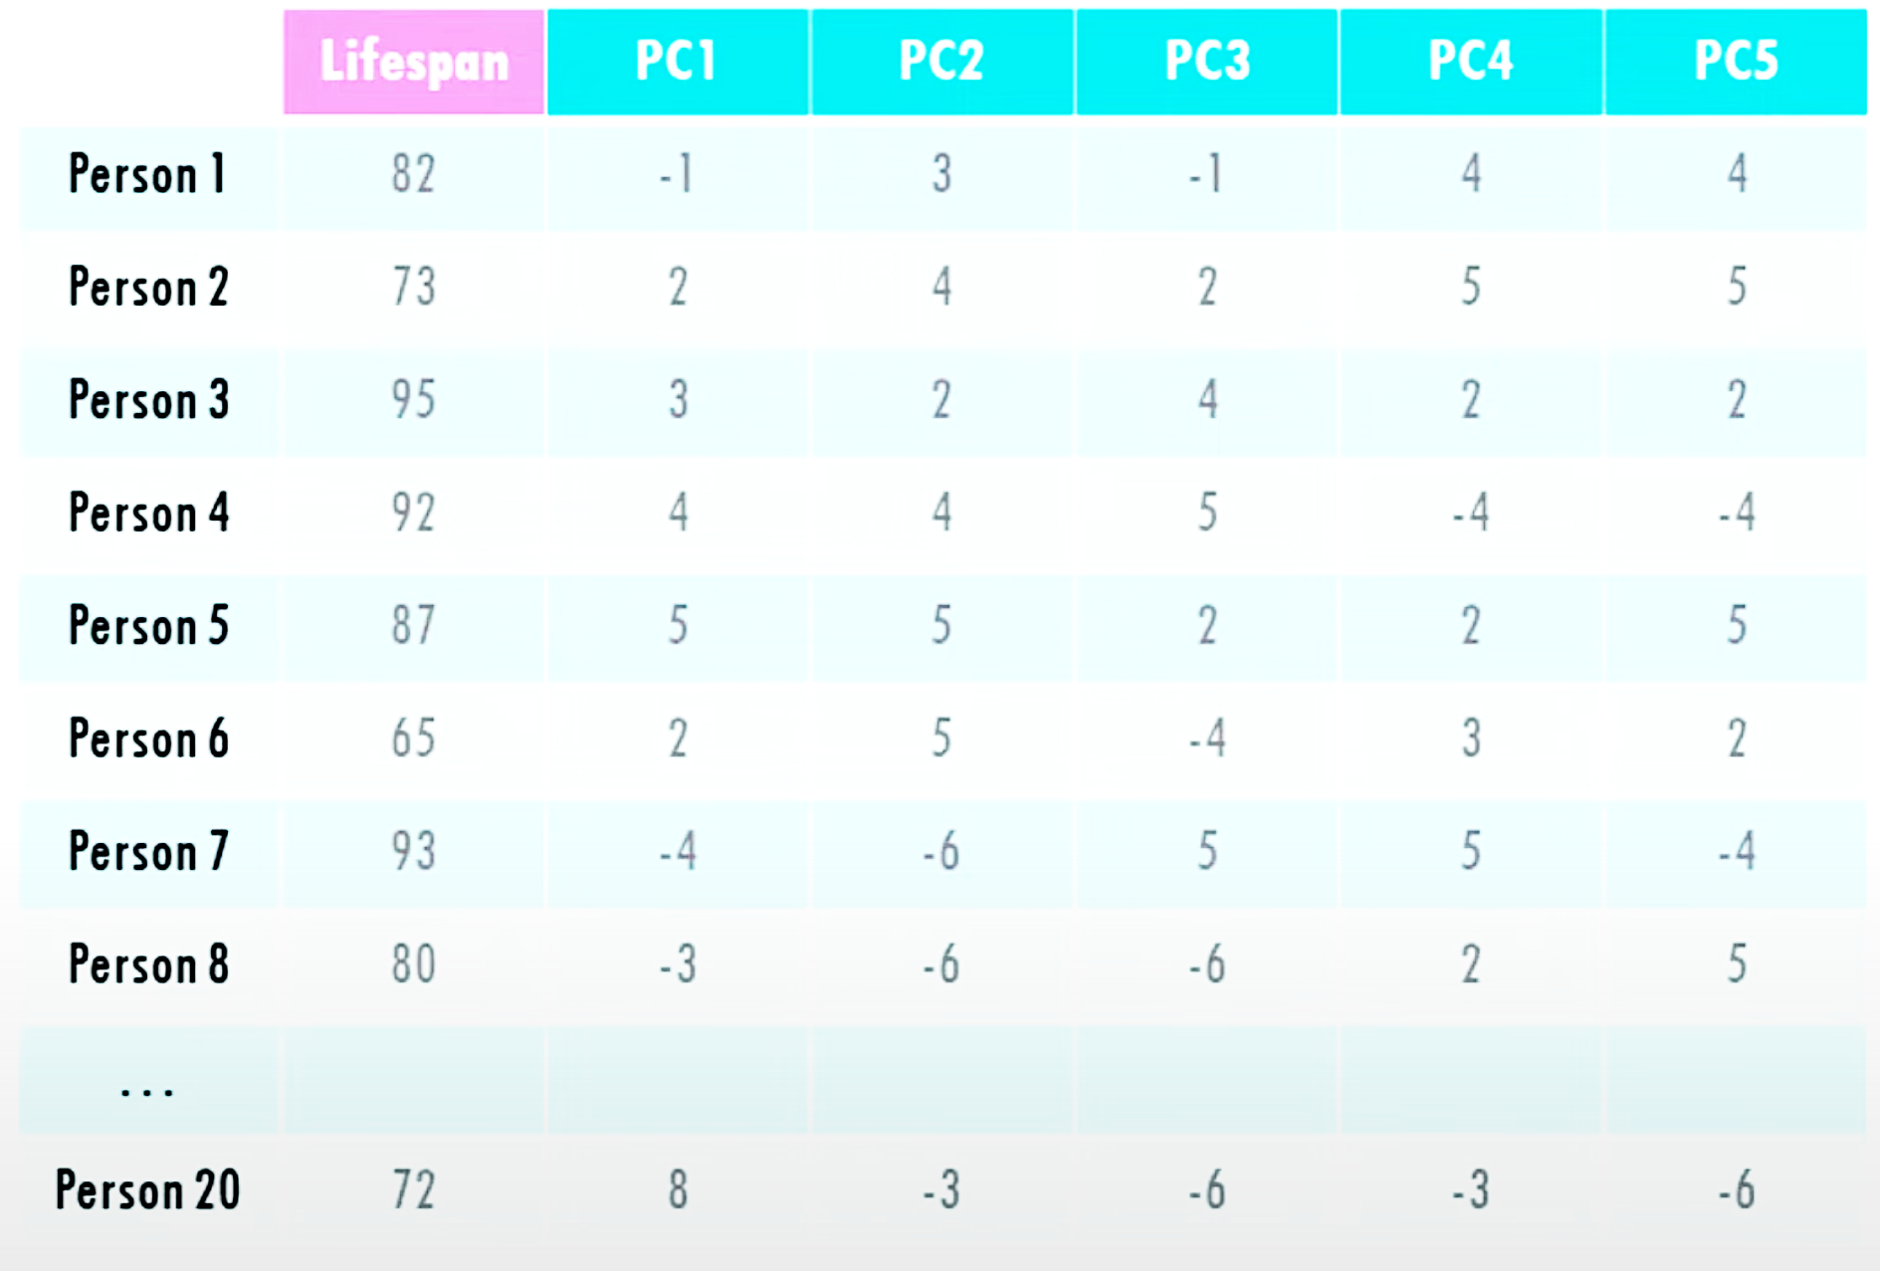

Slide 14
Principal Components are ranked
PC1 > PC2 > PC3 > PC4 > PC5

Slide 16
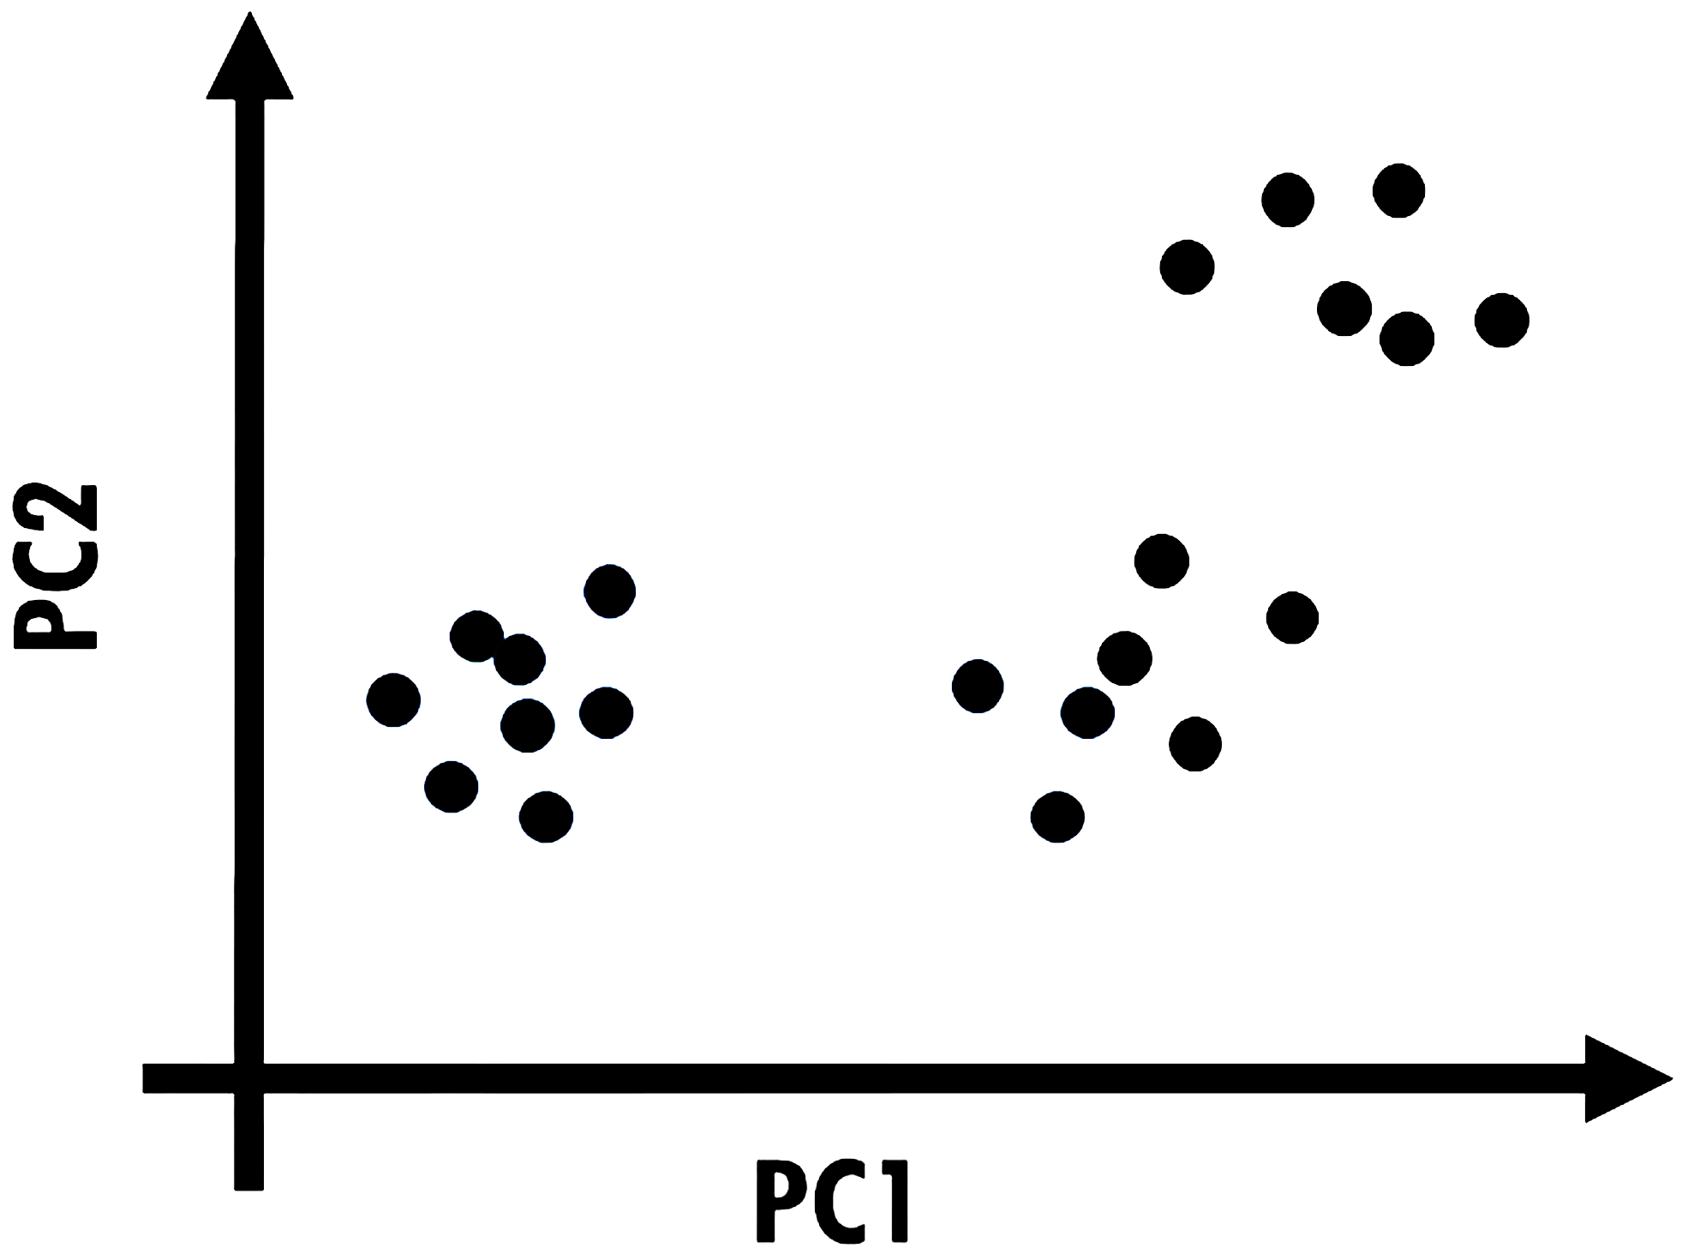

Slide 17
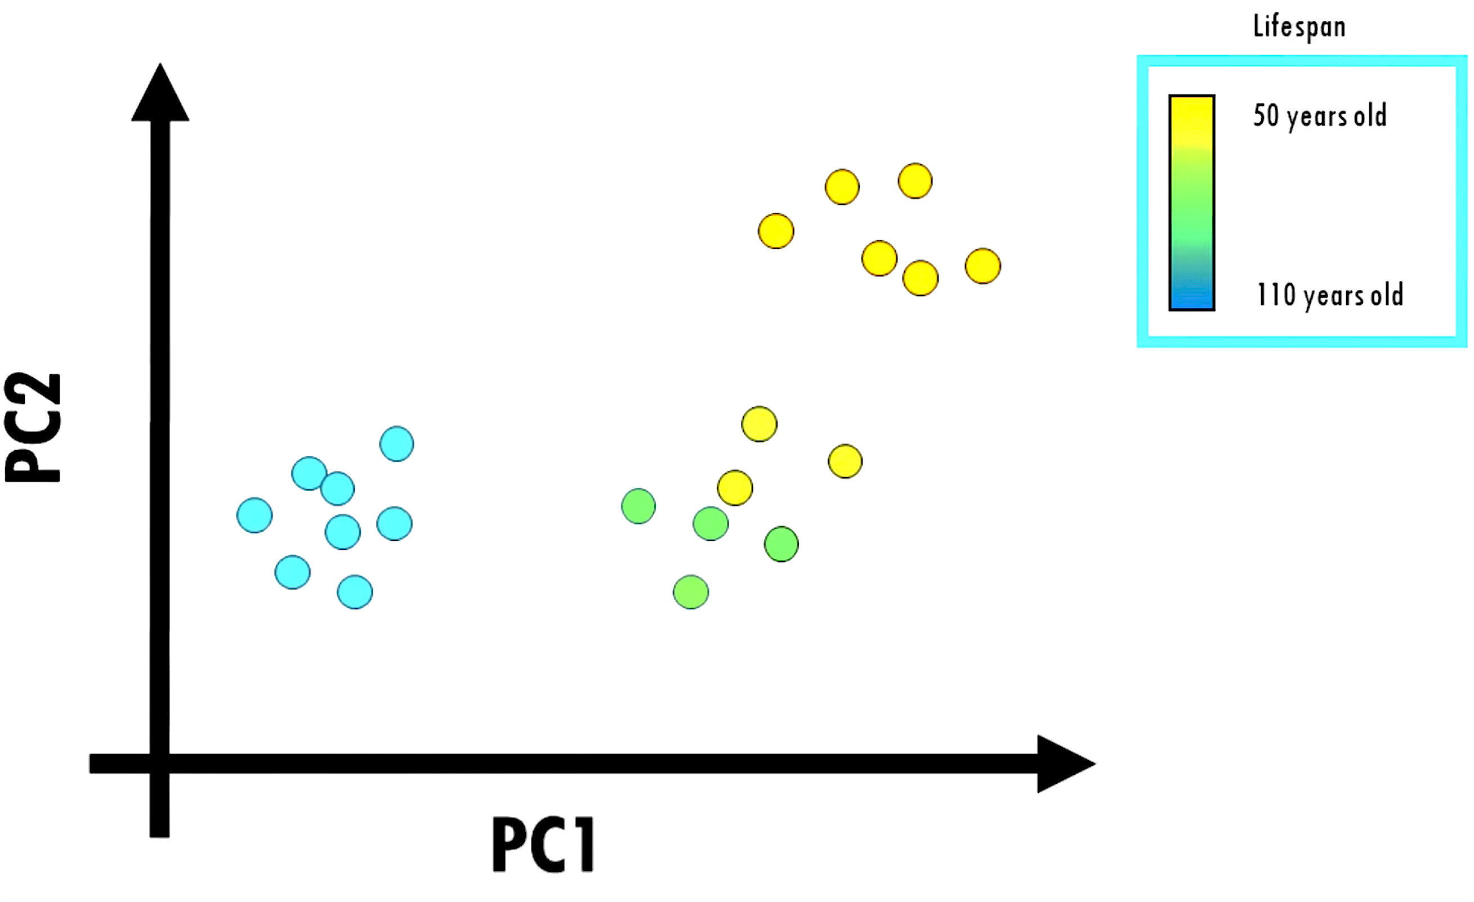

Slide 18


Slide 19
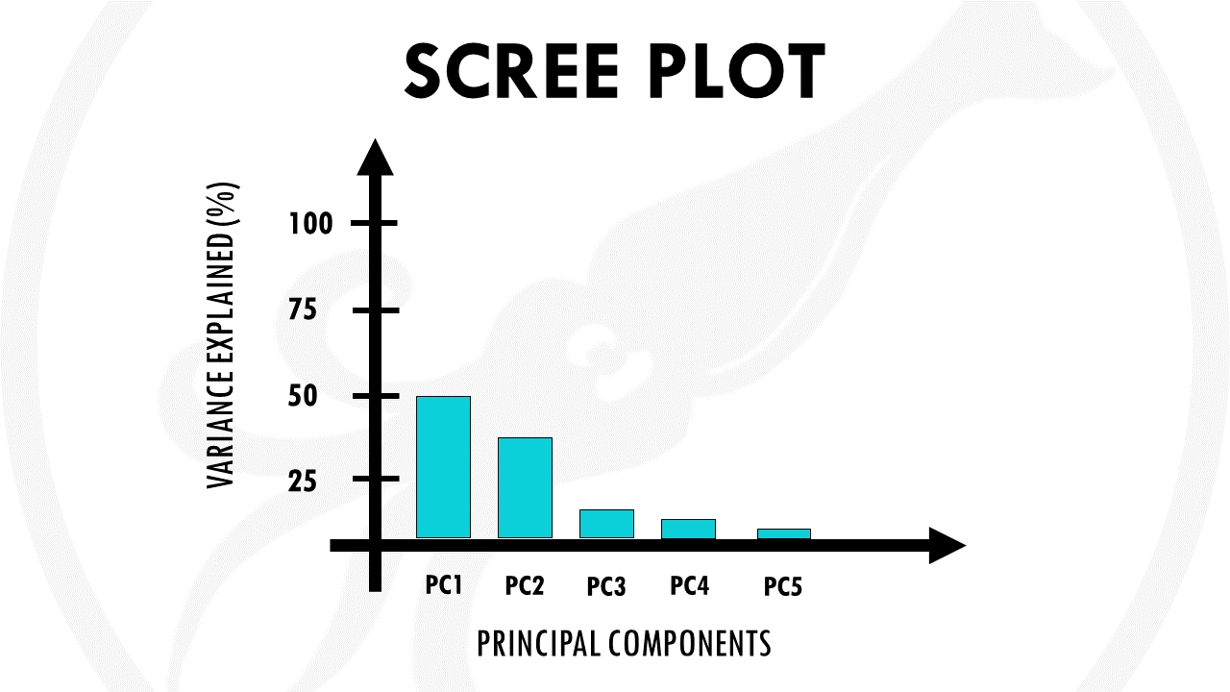

Slide 20
50%
Percent of variance explained

